Slide 1
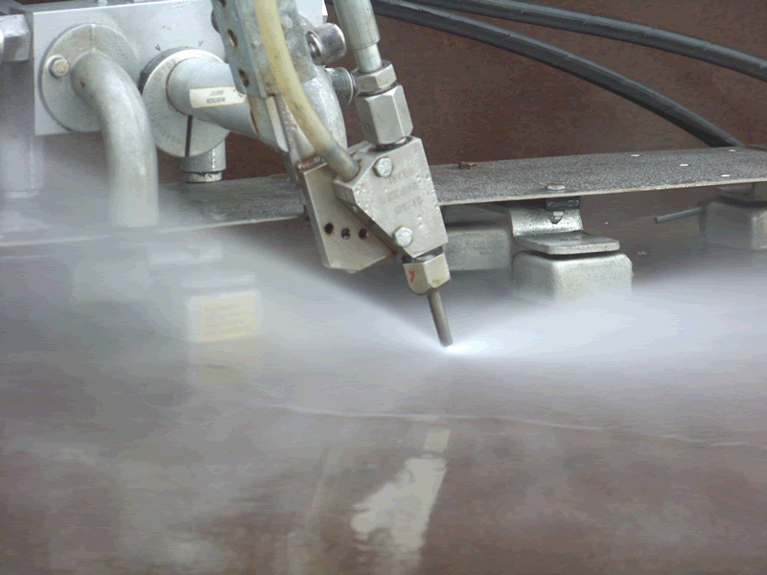
WATER JET MACHINING
Dr. S. Krishnamohan,
Professor/Mech
EGSPEC, Nagai

Slide 2
Water-jet machining
It is manufacturing through the use of highly pressurized liquid, forced through a nozzle and used as the cutting tool.
The orifice can range from 5 to 20 thousandth of an inch.

Slide 3
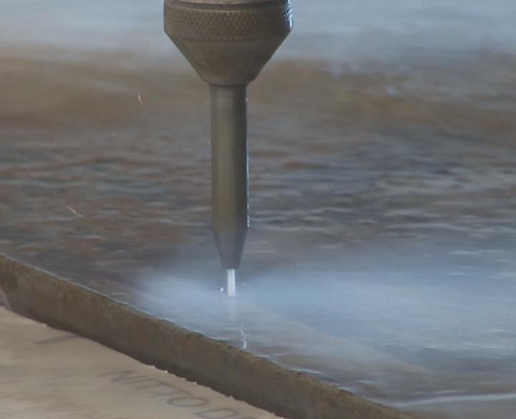
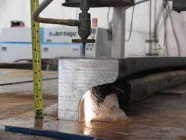
PRINCIPLE

Slide 4
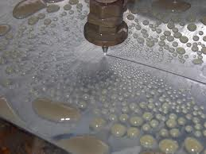
Water Jet Machining (WJM)
Water jet acts like a saw and cuts a narrow groove in the material.
Pressure level of the jet is about 400MPa.
Advantages
- no heat produced
- cut can be started anywhere without the need for predrilled holes
- burr produced is minimum
- environmentally safe and friendly manufacturing.
Application – used for cutting composites, plastics, fabrics, rubber, wood products etc. Also used in food processing industry.

Slide 5
Constructional Details of WJM

Slide 6
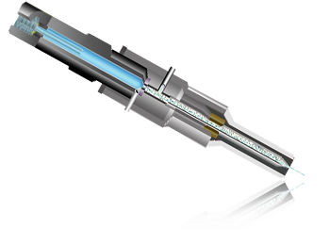

Slide 7
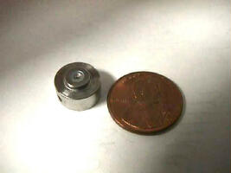
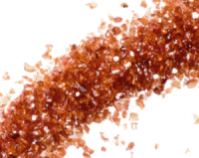
Components - Orifice
Jewel Orifice :
Diamond
0.01” diameter
Garnet Abrasive Particles

Slide 8
Working Principle

Slide 9
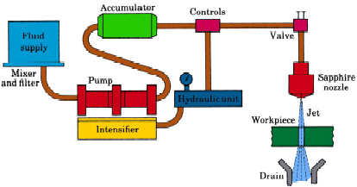
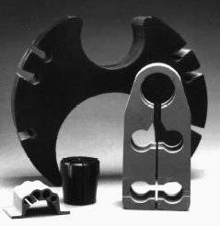
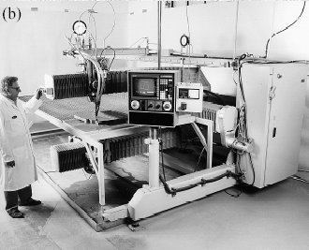
Water Jet Machining
Fig : (a) Schematic illustration of water-jet machining. (b) A computer-controlled, water-jet cutting machine cutting a granite plate. (c) Example of various nonmetallic parts produced by the water-jet cutting process.

Slide 10
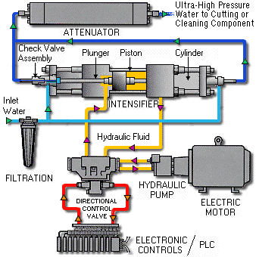
Water Jet Machining

Slide 11
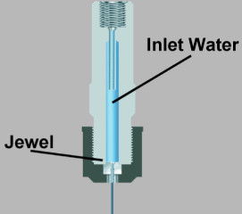
PROCESS PARAMETERS

Slide 12
1. Material Removal Rate (MRR)

Slide 13
2. Geometry and Surface finish of work material

Slide 14
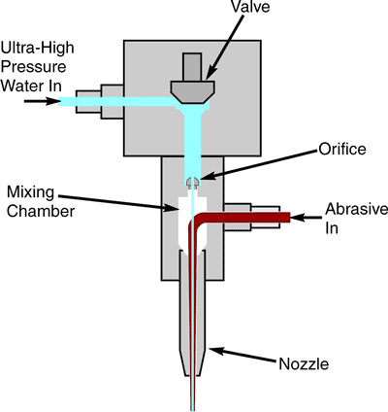
3. Wear Rate of the Nozzle

Slide 15
ADVANTAGES
DISADVANTAGES

Slide 16
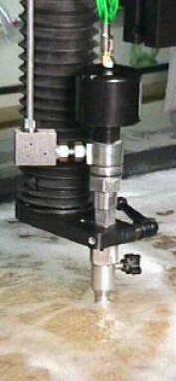
CHARACTERISTICS OF WJM

Slide 17
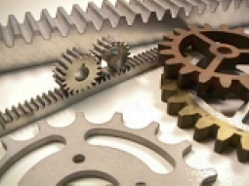
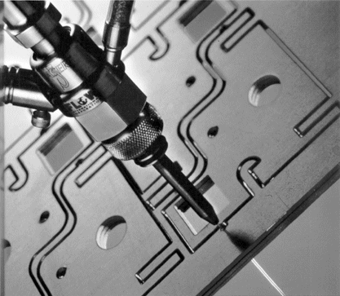
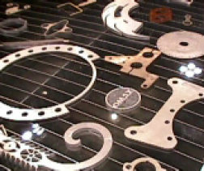
APPLICATIONS

Slide 18
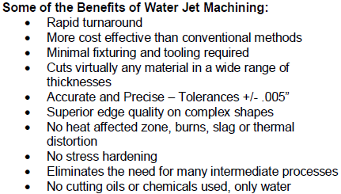
Some Benefits of WJM

Slide 19
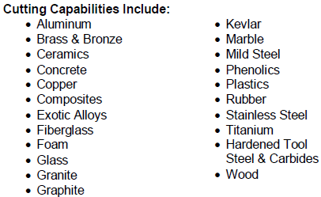
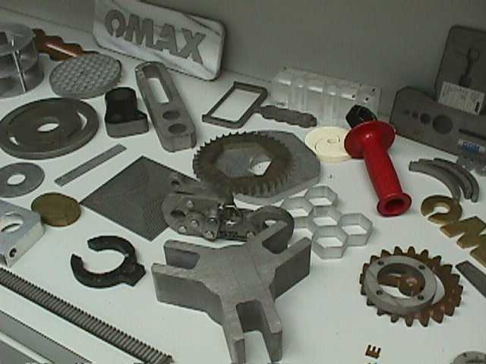
Cutting Capabilities Include

Slide 21
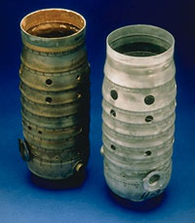
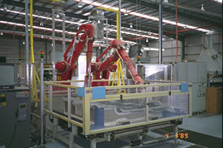
Applications
Aerospace
Automotive

Slide 22
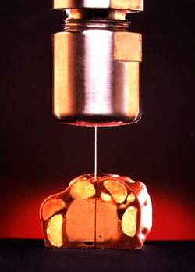
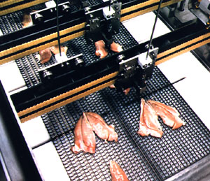
Applications
Food Processing

Slide 23
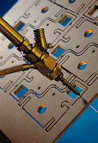
Applications
Electronics and PCBs

Slide 24
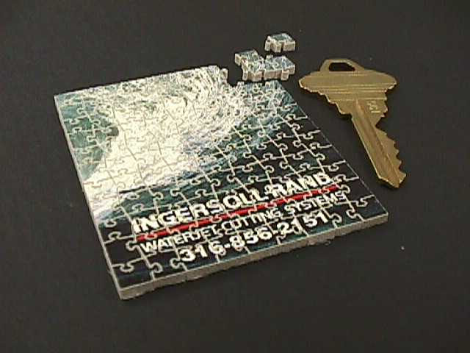
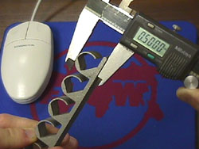
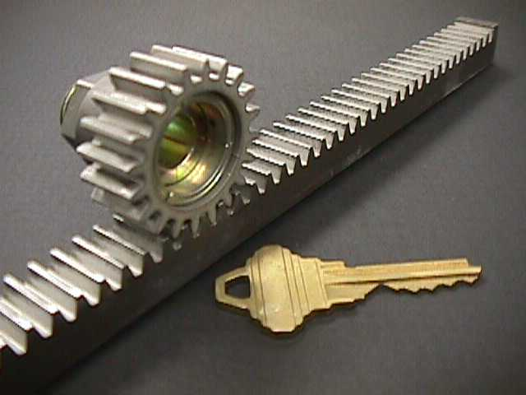
Applications
How Accurate We can get

Slide 25
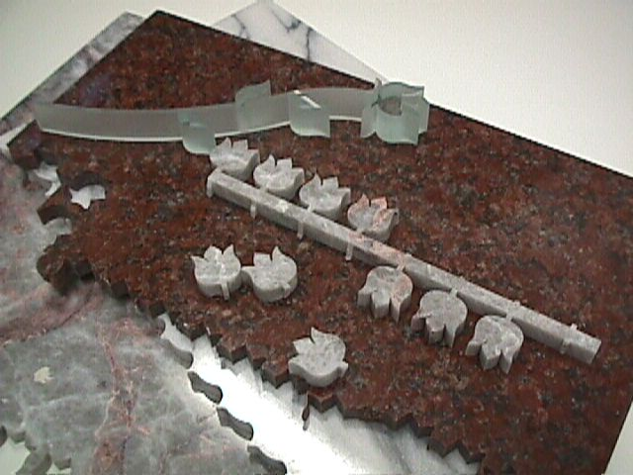
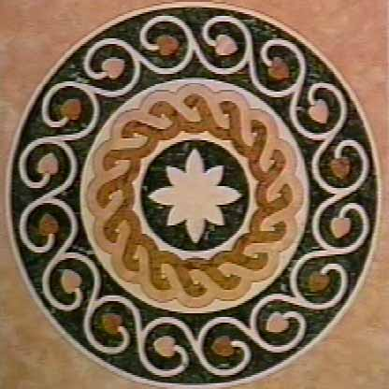
Applications
Marble Industry

Slide 26
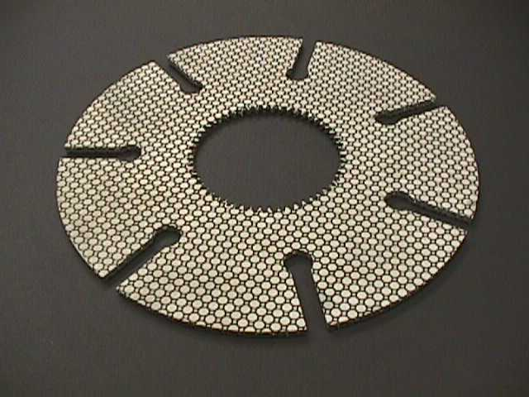
Applications
Lining

Slide 27
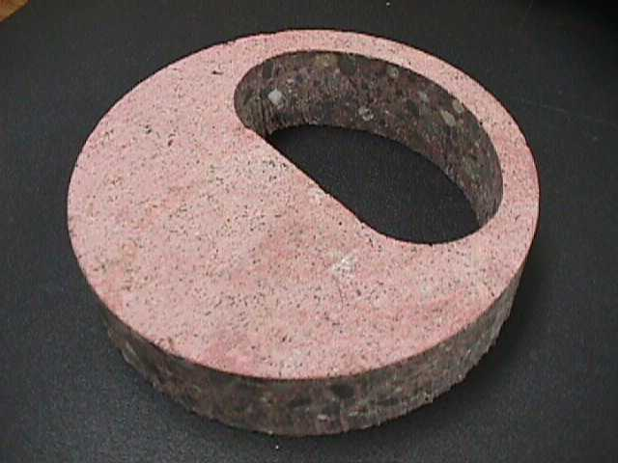
Applications
Concrete

Slide 28
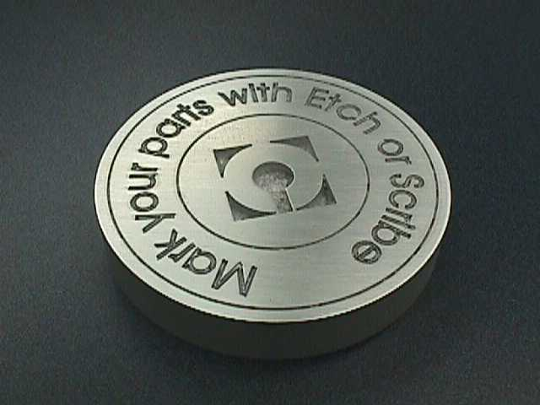
Applications
Aluminum

Slide 29
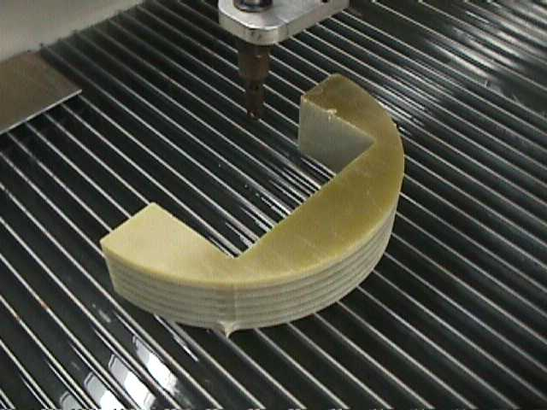
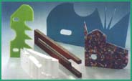
Applications
Polymers and Composites

Slide 30
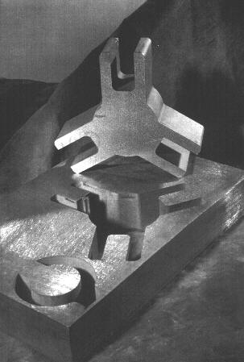
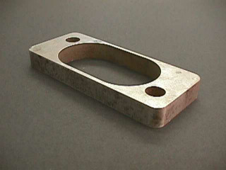
Applications
Steels With Different Thickness

Slide 31
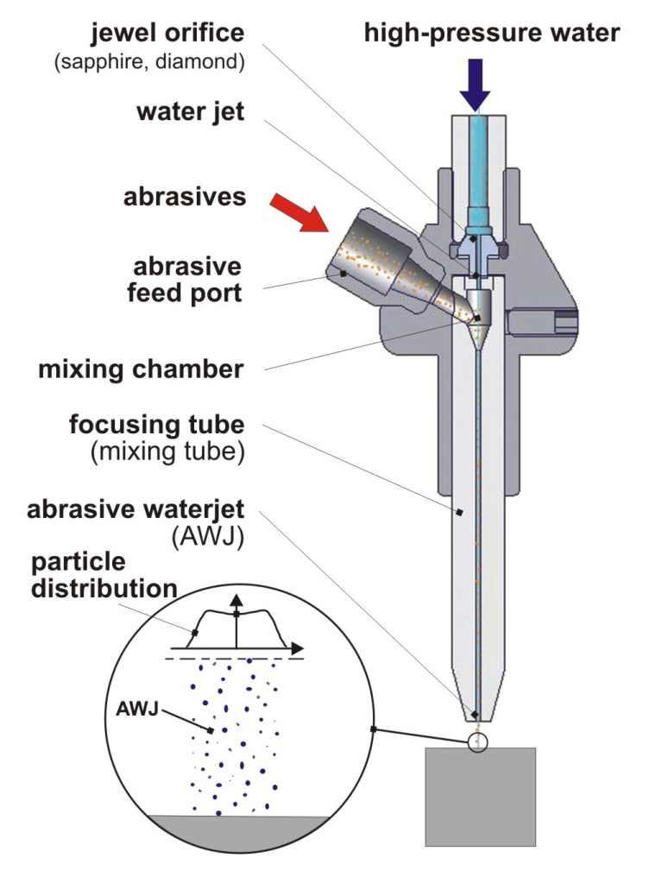
RECENT DEVELOPMENT IN WJM

Slide 32
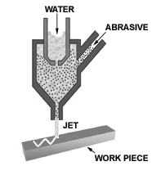
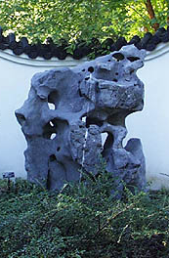
Water-Jet, Abrasive Water-Jet Machining
- Workpiece is fractured by impact from
high pressure (~400 MPa) water-jet
- No heat ➔ no thermal stress, damage
Common applications:
- Fast and precise cutting of fabrics
- Vinyl, foam coverings of car dashboard panels
- Plastic and composite body panels used in the interior of cars
- Cutting glass and ceramic tiles

Slide 34
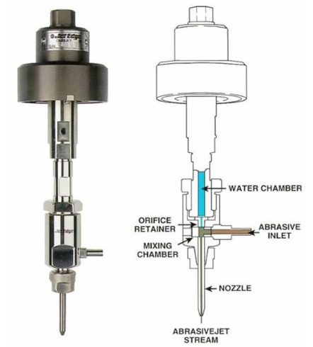

Slide 35
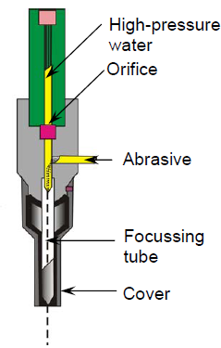
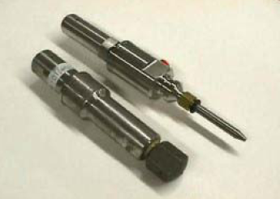

Slide 36
