Slide 1
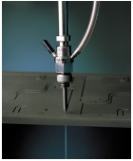
ABRASIVE JET MACHINING
Dr. S. Krishnamohan,
Professor/Mech
EGSPEC, Nagai

Slide 2
Mechanical Energy Based Processes

Slide 3
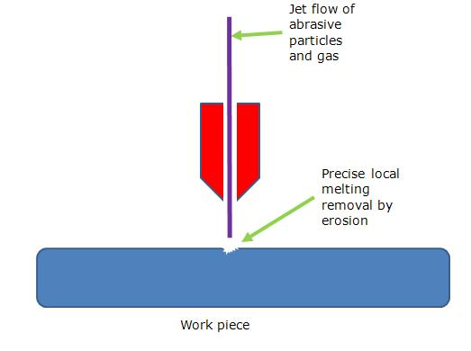
ABRASIVE JET MACHINING (AJM)
Abrasive jet machining (AJM), also known as abrasive micro-blasting, pencil blasting and micro-abrasive blasting, is an abrasive blasting machining process that uses abrasives propelled by a high velocity gas to erode material from the workpiece.

Slide 4
Abrasive Jet Machining
Abrasive Machines are extremely versatile and have limitless applications.
They have the power to cut and drill materials as hard as diamonds as well as the precision of delicate items like fabric and paper.

Slide 5
PRINCIPLE OF AJM

Slide 6
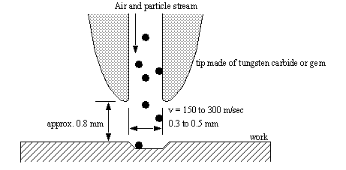
AJM

Slide 7
Constructional Details of AJM

Slide 8
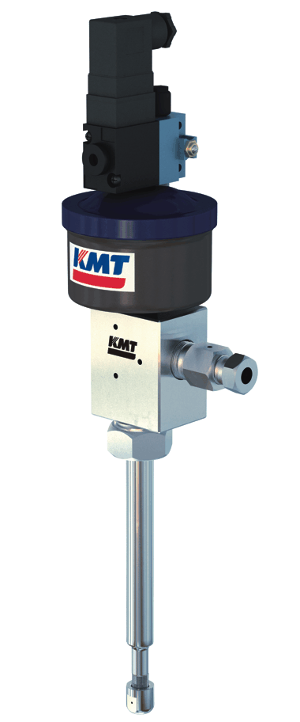

Slide 9
Fig. Arrangement of Abrasive Jet Machining

Slide 10
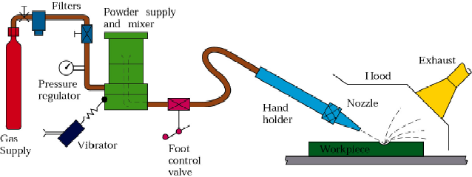
Abrasive Jet Machining
Fig : Schematic illustration of Abrasive Jet Machining

Slide 11
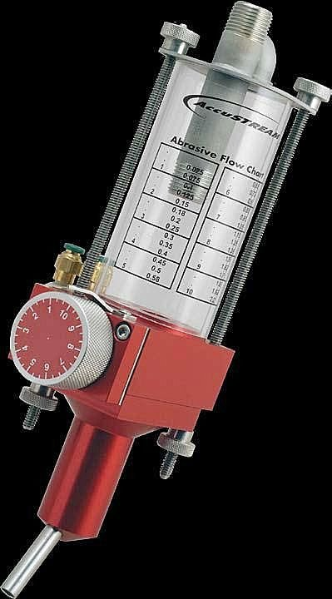
Working Principle

Slide 12
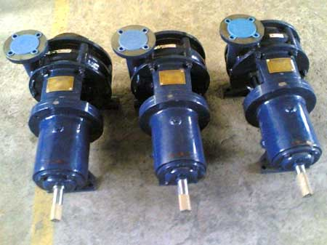

Slide 13
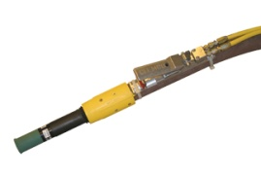

Slide 14
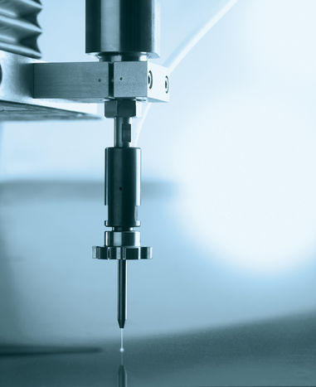
METAL REMOVAL RATE PROCESS PARAMETERS

Slide 15
1. Mass Flow Rate

Slide 16
2. Abrasive Grain Size

Slide 17
3. Gas Pressure

Slide 18
4. Velocity of Abrasive Particles

Slide 19
5. Mixing Ratio

Slide 20
6. Nozzle Tip Clearance or Stand-off Distance

Slide 23
ADVANTAGES OF AJM

Slide 24
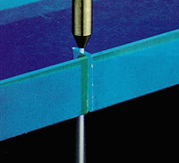
DISADVANTAGES OF AJM

Slide 25
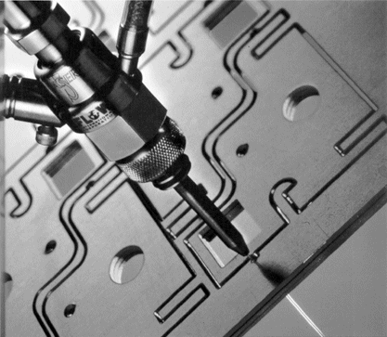
APPLICATIONS OF AJM

Slide 26
CHARACTERISTISTICS OF AJM

